Slide 1
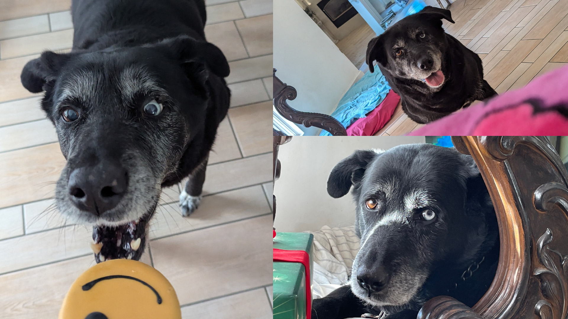

15+ Years
6,238 Walks
11,229 Miles
32,857 Treats
1 Buddy

Slide 2

delivering innovative, unforgettable treat experiences for all dogs

Slide 3

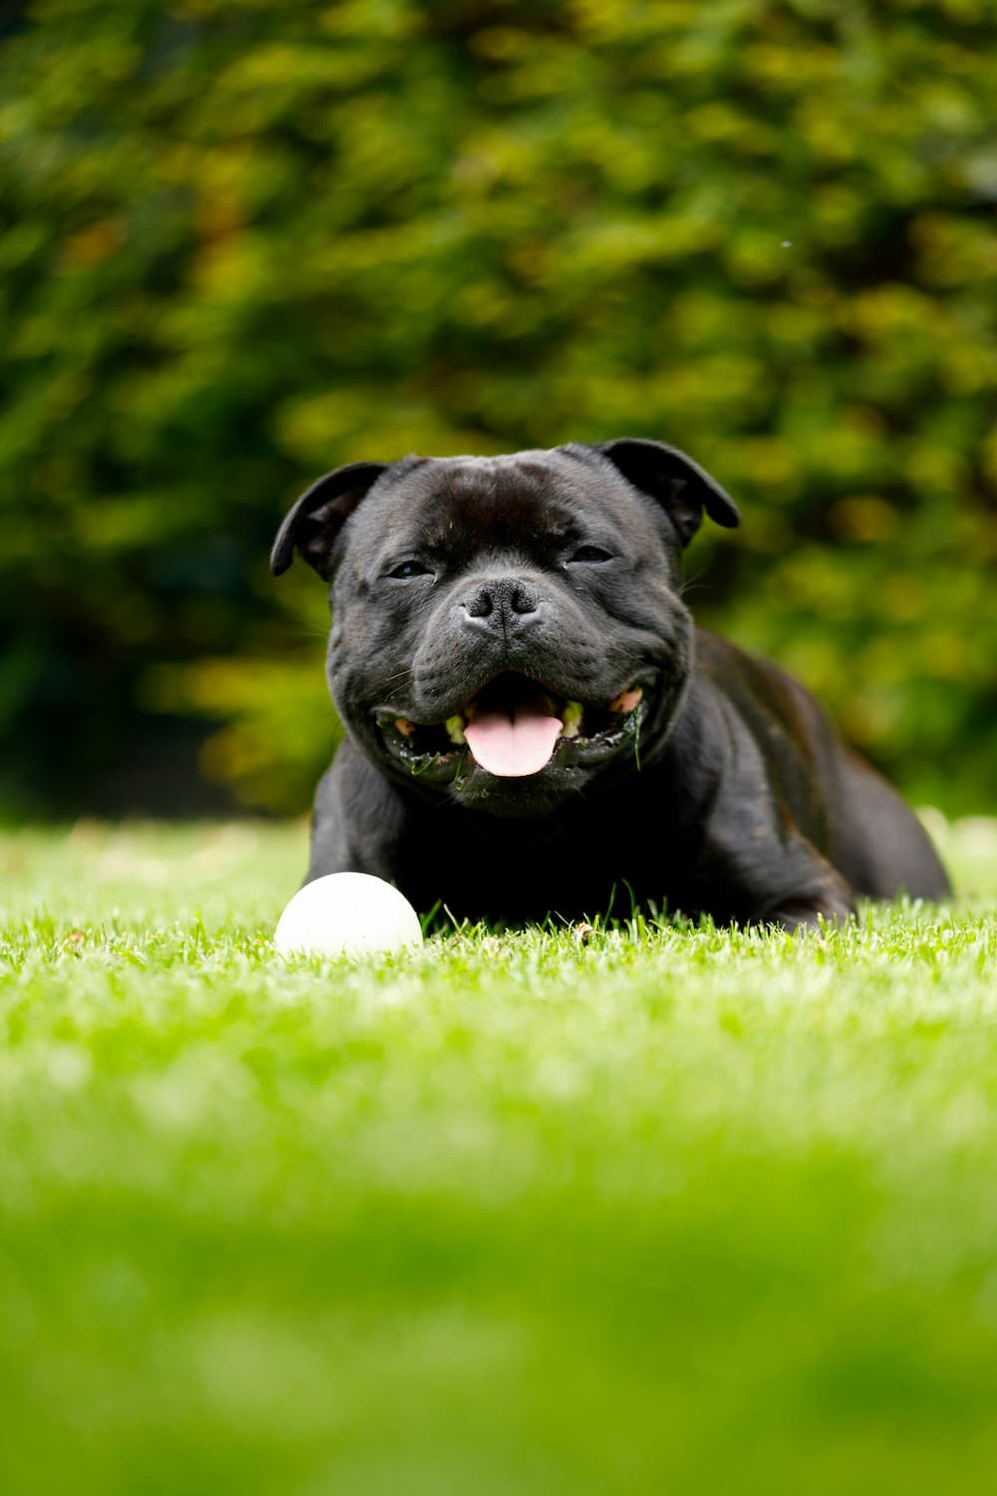
Background information
Better target and market the world’s best treat developed specifically for dogs
Provide the most optimal treat experience for all different types of dog breeds
Be as good to our dogs as they are to us

Slide 4
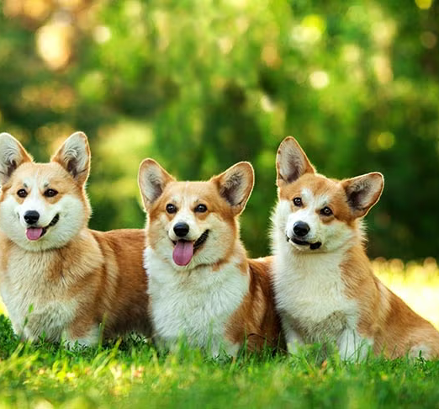
Languages & Environment
Python
MySQL
Google Colab
Jupyter Notebook
MySQLWorkbench
GitHub

Slide 5
Data Sources
External
American Kennel Club (AKC) dataset
breed, temperament, popularity, min_height, max_height, min_weight, max_weight, min_expectancy, max_expectancy, group, energy_level_value, energy_level_category, trainability_value, trainability_category, demeanor_value, demeanor_cateogory
Austin Animal Center Outcomes dataset
name, dob, sex, color, age, type, outcome_type, outcome_subtype, outcome_datetime
Region dataset – US Census Bureau and The American Veterinary Medical Association (AVMA)
median_income, pet_ownership
Internal
Doggy Delights customer content
treat_consumption
product_catalog
survey_response

Slide 6
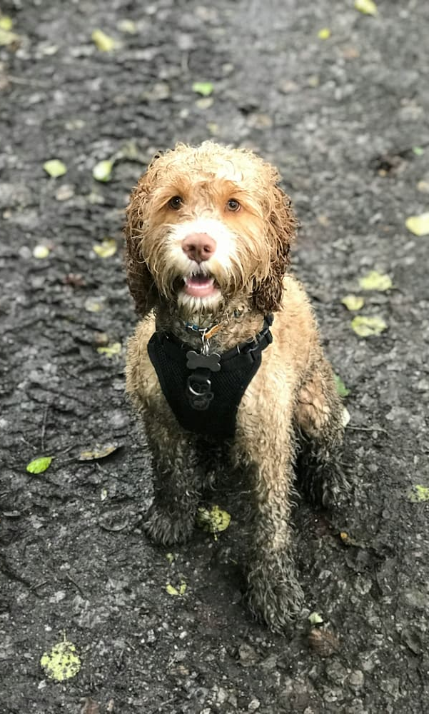
Data quality checks & cleaning
Data cleaning
Before extraction, ETL (Extraction/Transformation/Load)
Incorrect formats, data types, missing values, outliers, duplicate records, NaN
Quality checks
Before data is entered into the database
Form validation on customer survey
Not NULL
Data usage
Access is restricted to authorized employees only to comply with best practice privacy regulations

Slide 7
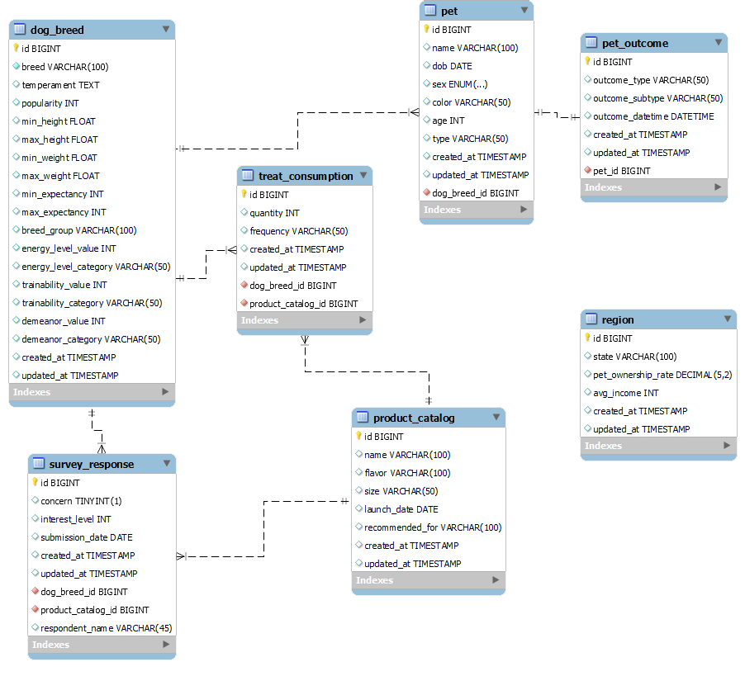
EER Diagram/Database Schema

Slide 8
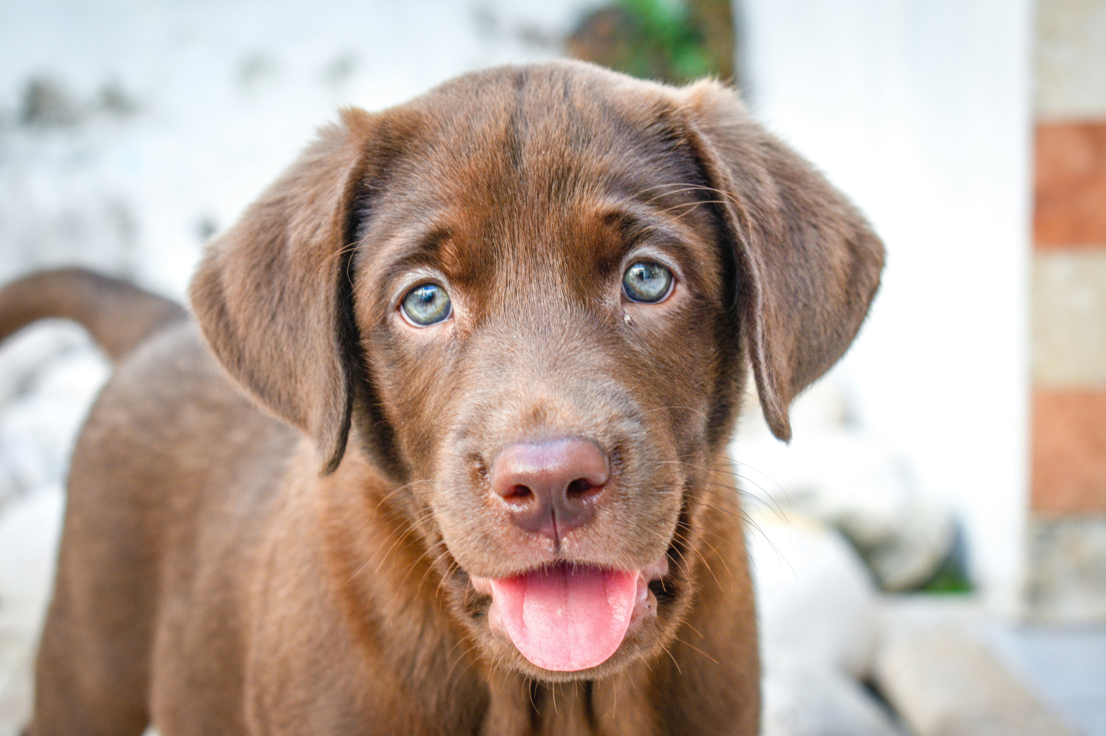
Tables
Dimension Tables
dog_breed
pet
pet_outcome
product_catalog
region
Fact Tables
treat_consumption
survey_response

Slide 9
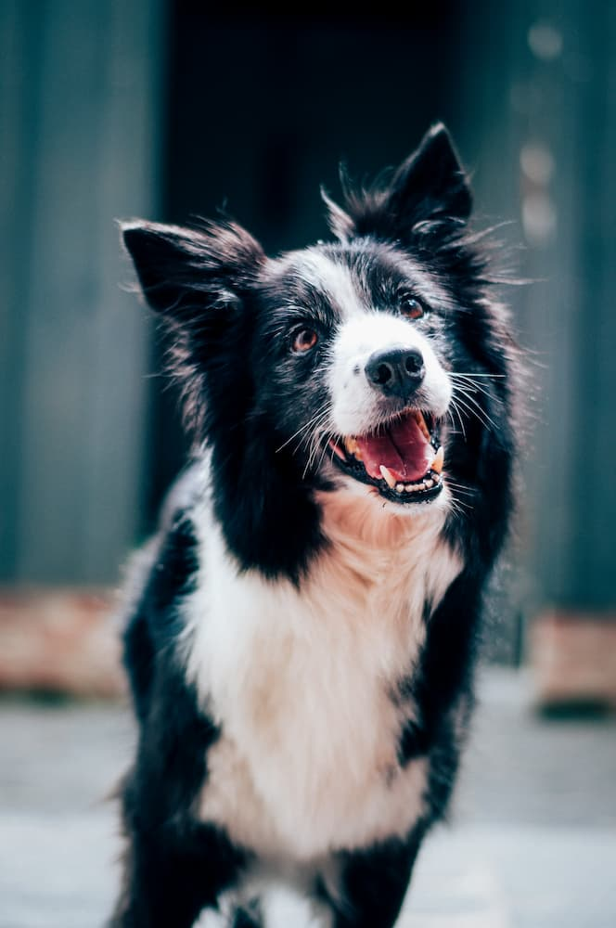




Database Storage
MySQL running on a web server
Not meant for public use and restricted to key employees
Web host provides daily backup and data recovery plan in place to help minimize the potential for a loss of data
MySQL DDB
Google Colab/
Jupyter Notebook
SSH Tunnel
Web Form

Slide 10
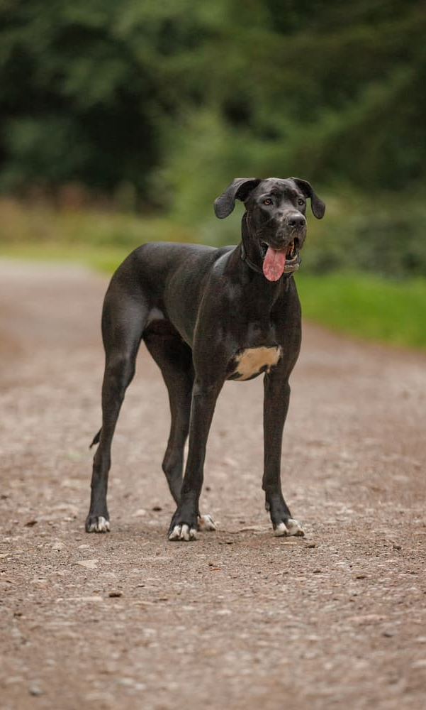
What dog breeds are likely to consume the most treats?
SELECT breed, energy_level_value, popularity,
(energy_level_value * (max_weight + min_weight) / 2 ) AS energy_score
FROM dog_breed
WHERE energy_level_value > 0
AND popularity > 0
ORDER BY energy_score DESC, popularity
LIMIT 10

Slide 11
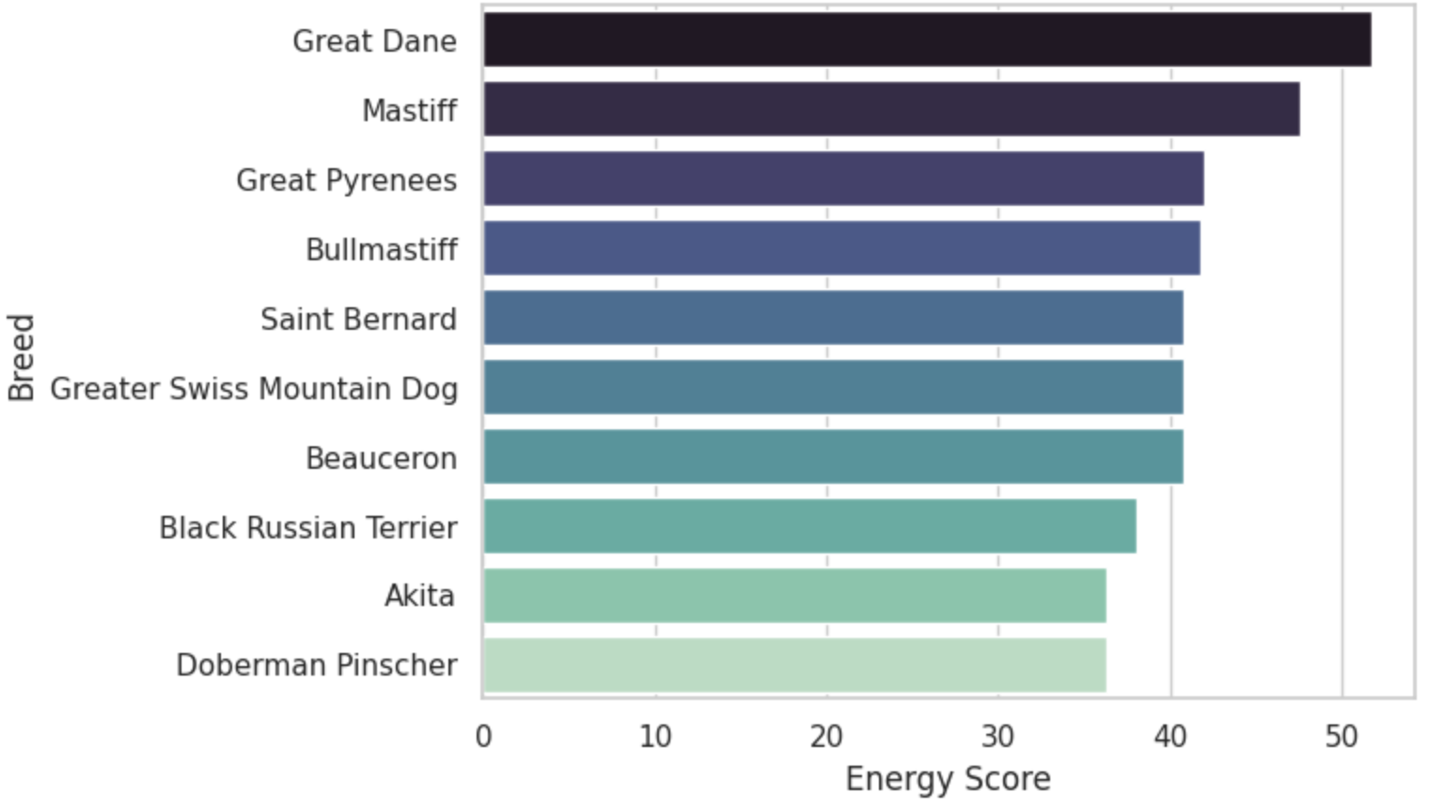
What dog breeds are likely to consume the most treats?

Slide 12
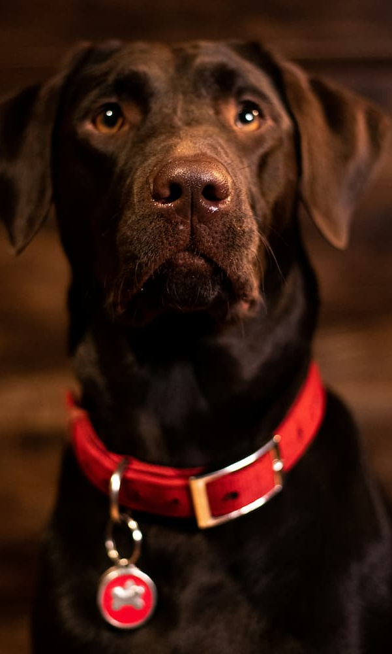
What ARE the most popular dog breeds?
SELECT breed, COUNT(*) AS breed_count
FROM dog_breed
INNER JOIN pet ON dog_breed.id = pet.dog_breed_id
GROUP BY breed
ORDER BY breed_count DESC
LIMIT 10

Slide 13
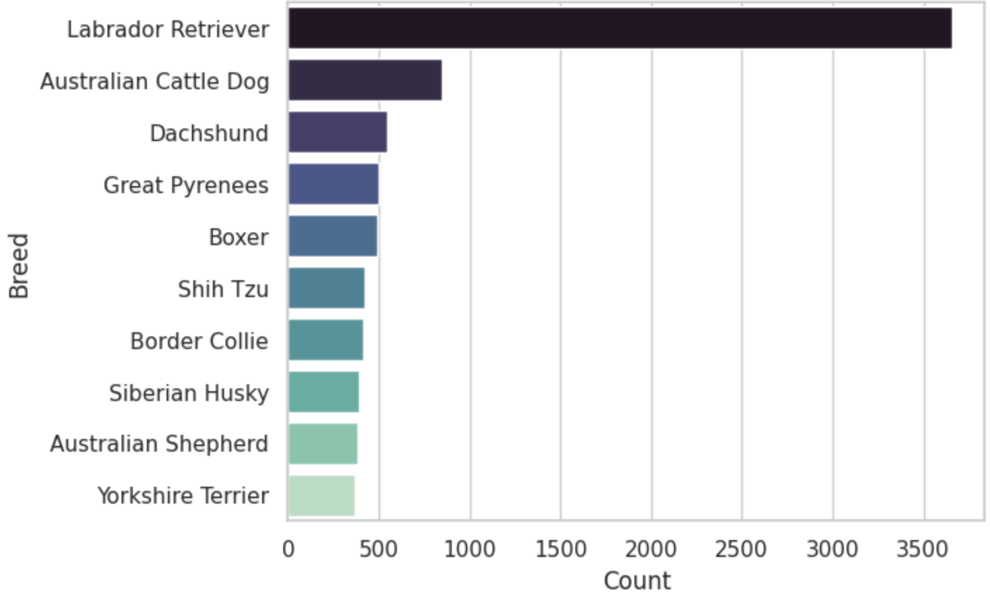
What ARE the most popular dog breeds?

Slide 14

Survey: Most Owned Breeds
SELECT breed as breed_name, count(dog_breed_id) as owned_by_ppl
FROM survey_response sr
JOIN dog_breed db
ON sr.dog_breed_id = db.id
GROUP BY dog_breed_id
ORDER BY owned_by_ppl DESC
LIMIT 3

Slide 15
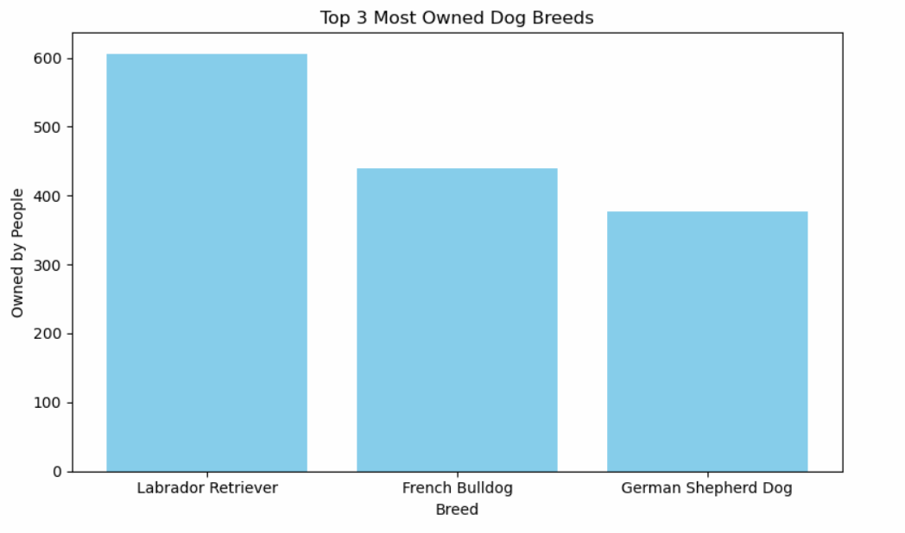
Survey: Most Owned Breeds

Slide 16
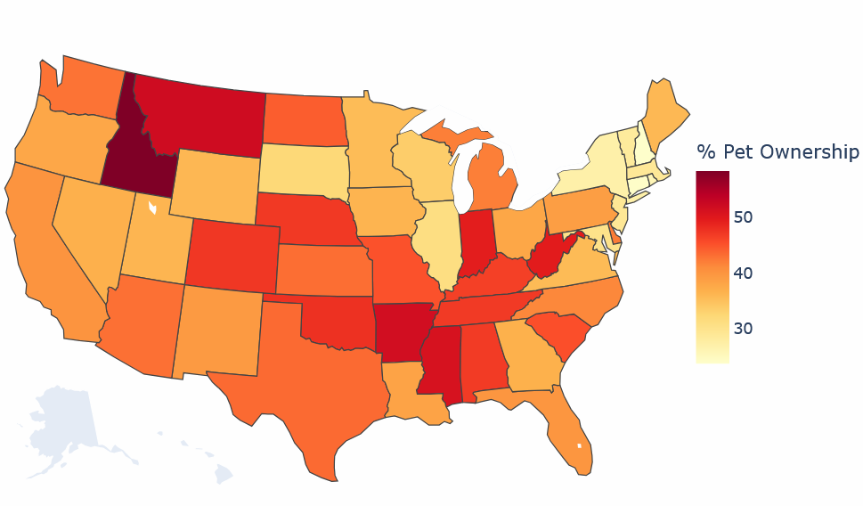
Pet ownership by state
Idaho: 58%
New Jersey: 29%
California: 40%

Slide 17
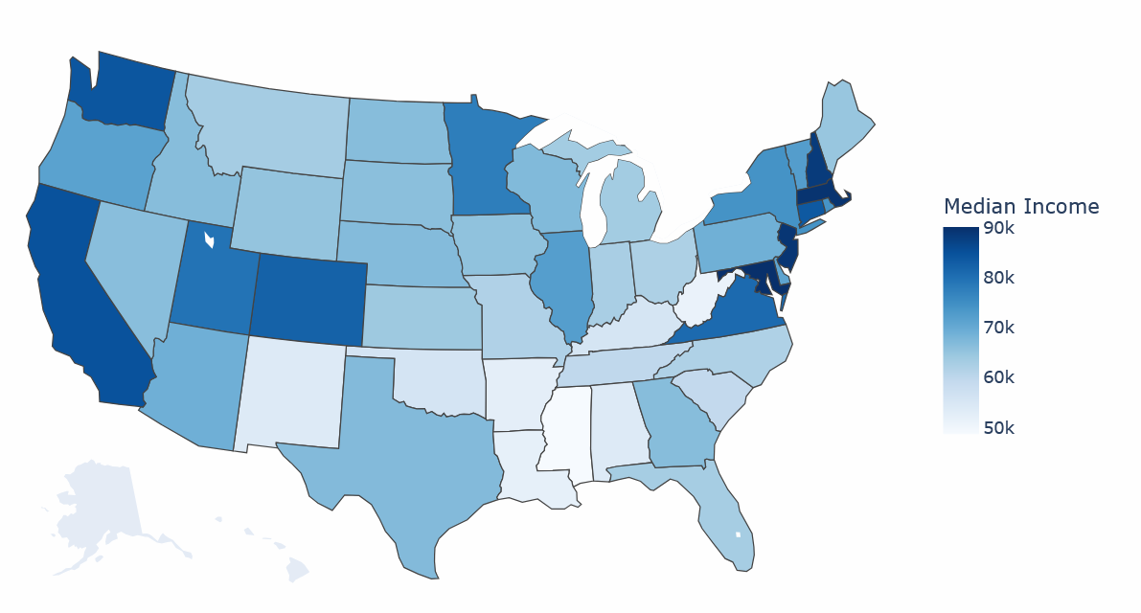
Median income by state
Idaho: $66K
New Jersey: $89K
California: $84K

Slide 18
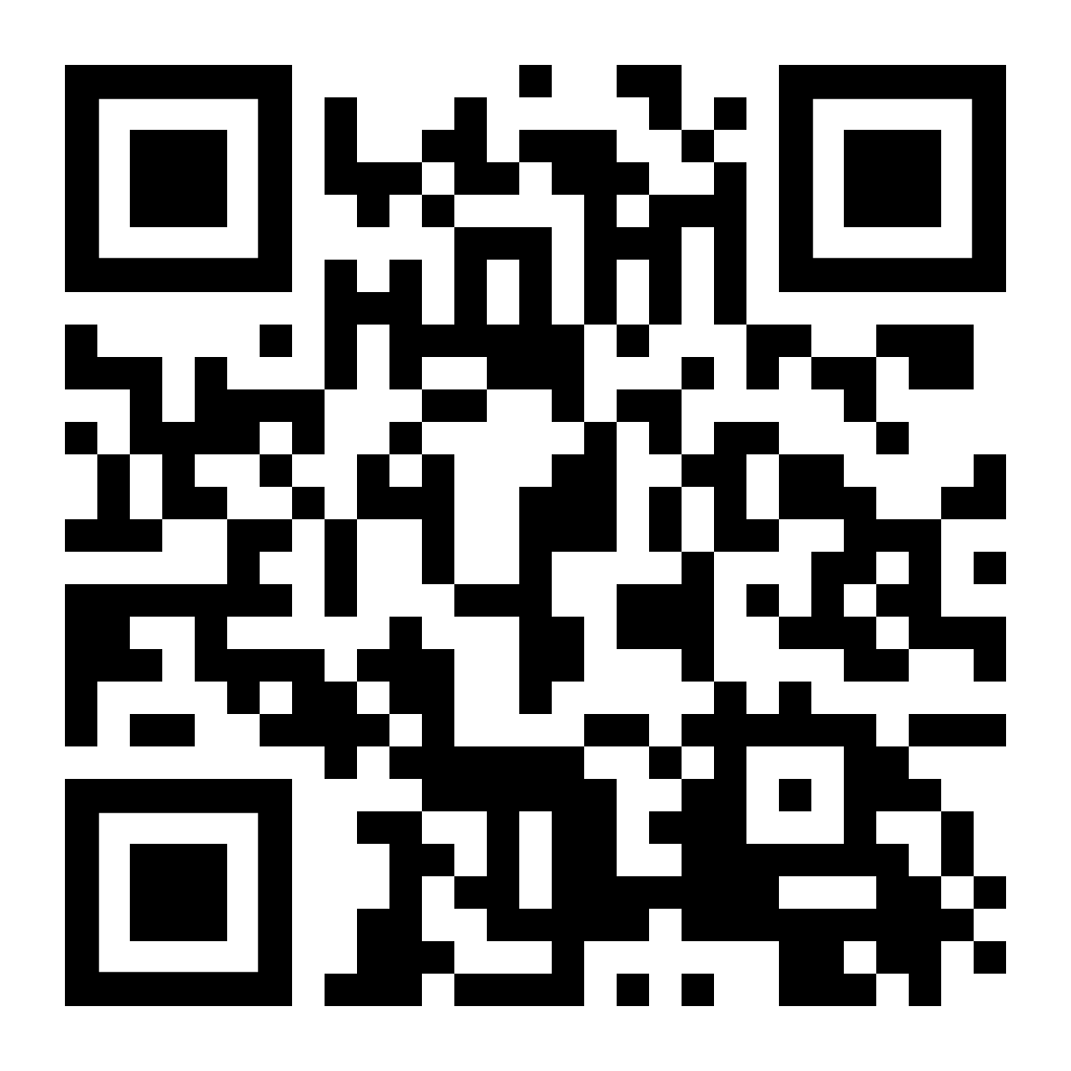

Conclusion
Our data aids Doggy Delights in making critical business decisions
How best to spend marketing budget to efficiently target new and existing customers
Whom to feature in product marketing
As our data grows
It can help dogs and owners find the perfect healthy treats
The data can help grow sales
joedag32
Decabra

Slide 19
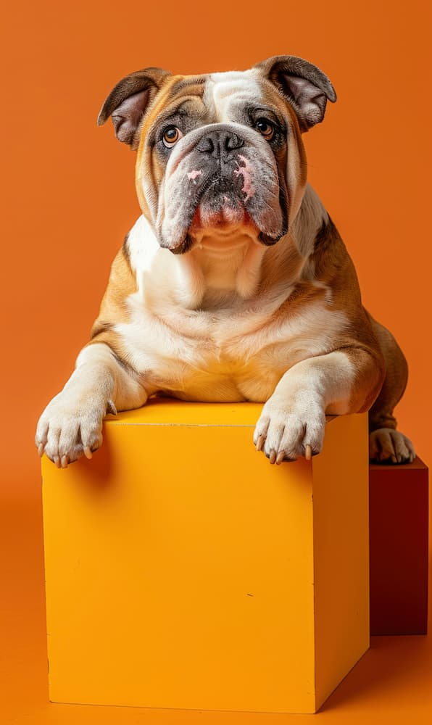
Any data or dog questions?
joedag32
Decabra

